Slide 1
Using unsupervised learning in search of new physics
Sakarias Garcia de Presno Frette

Slide 2
Outline
Motivation for the project
Machine learning phenomenology
Implementation
Results
Topics for discussion

Slide 3
Using auto encoder for anomaly detection with ATLAS open data
Attempt to see if the auto encoder can learn, without copying, to reconstruct sm processes and filter out new physics
Test against new physics models

Slide 4
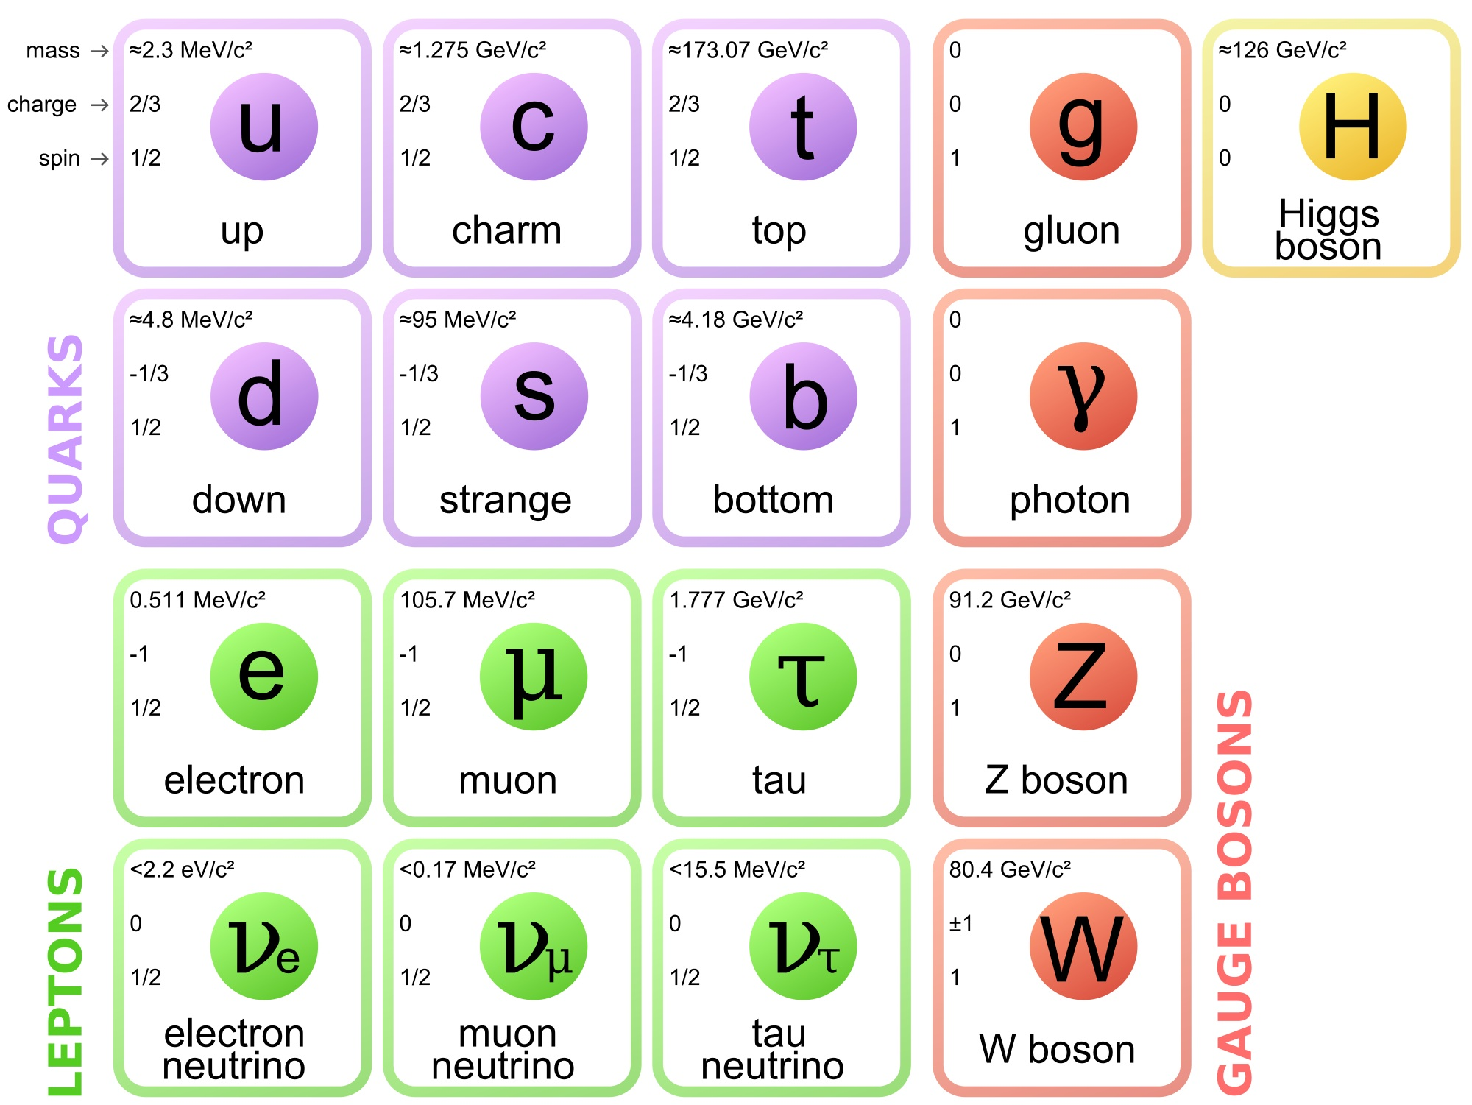
Motivation for BSM searches
Success of the standard model
Why BSM searches
No dark matter candidate
Gravity
source: https://www.quantumdiaries.org/2014/03/14/the-standard-model-a-beautiful-but-flawed-theory/

Slide 5
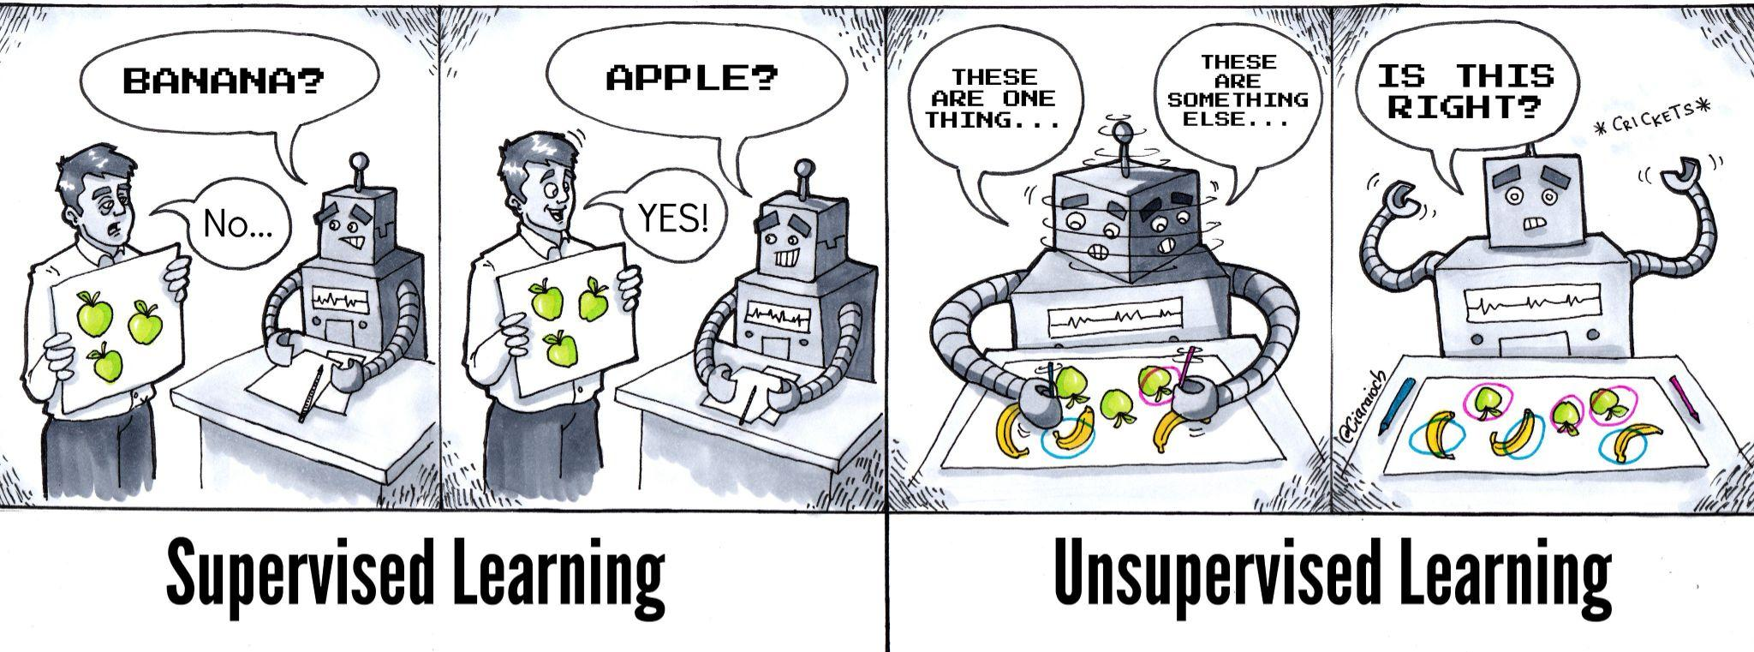
Model independent vs model dependent searches
Bias
Semi-unsupervised vs unsupervised
Auto encoder
Source: https://twitter.com/athena_schools/status/1063013435779223553

Slide 6
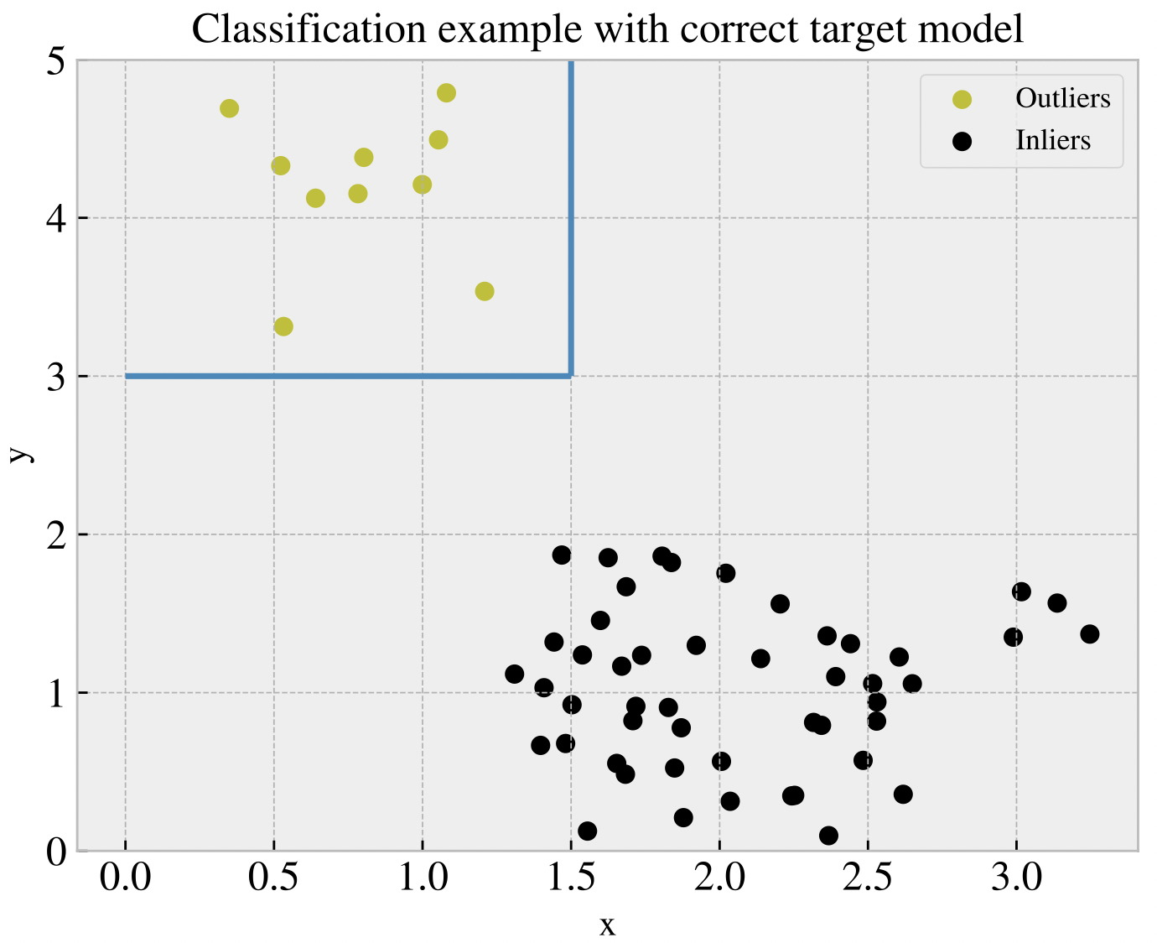
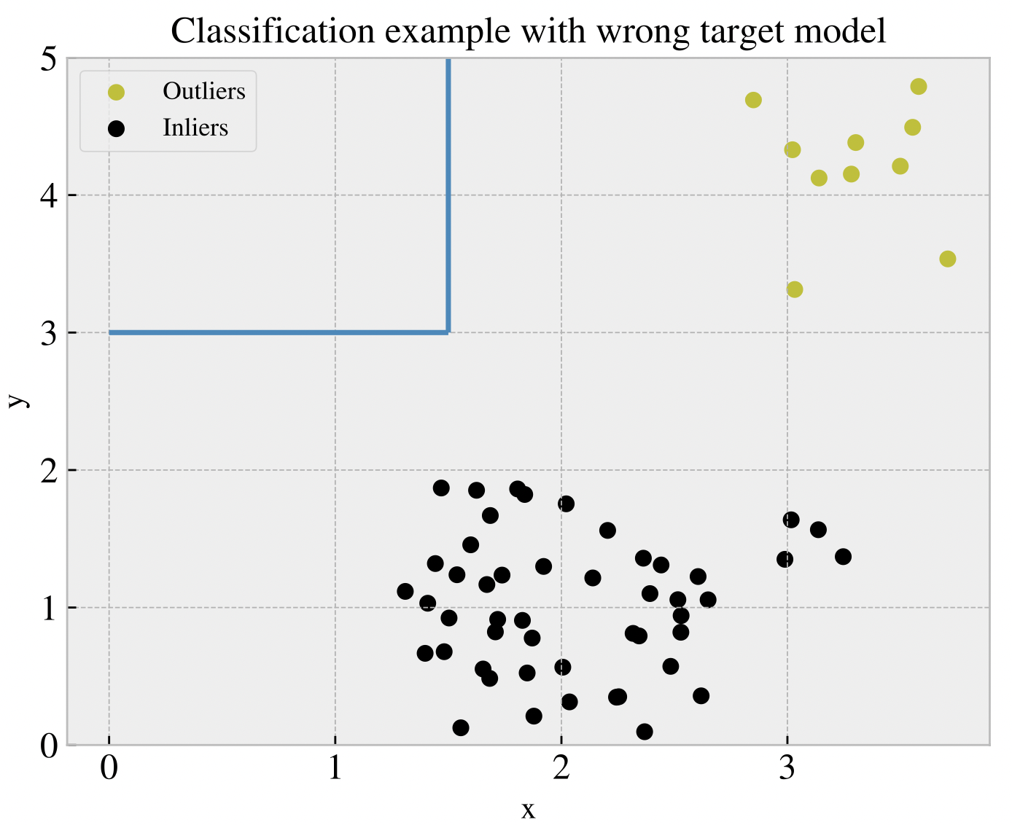
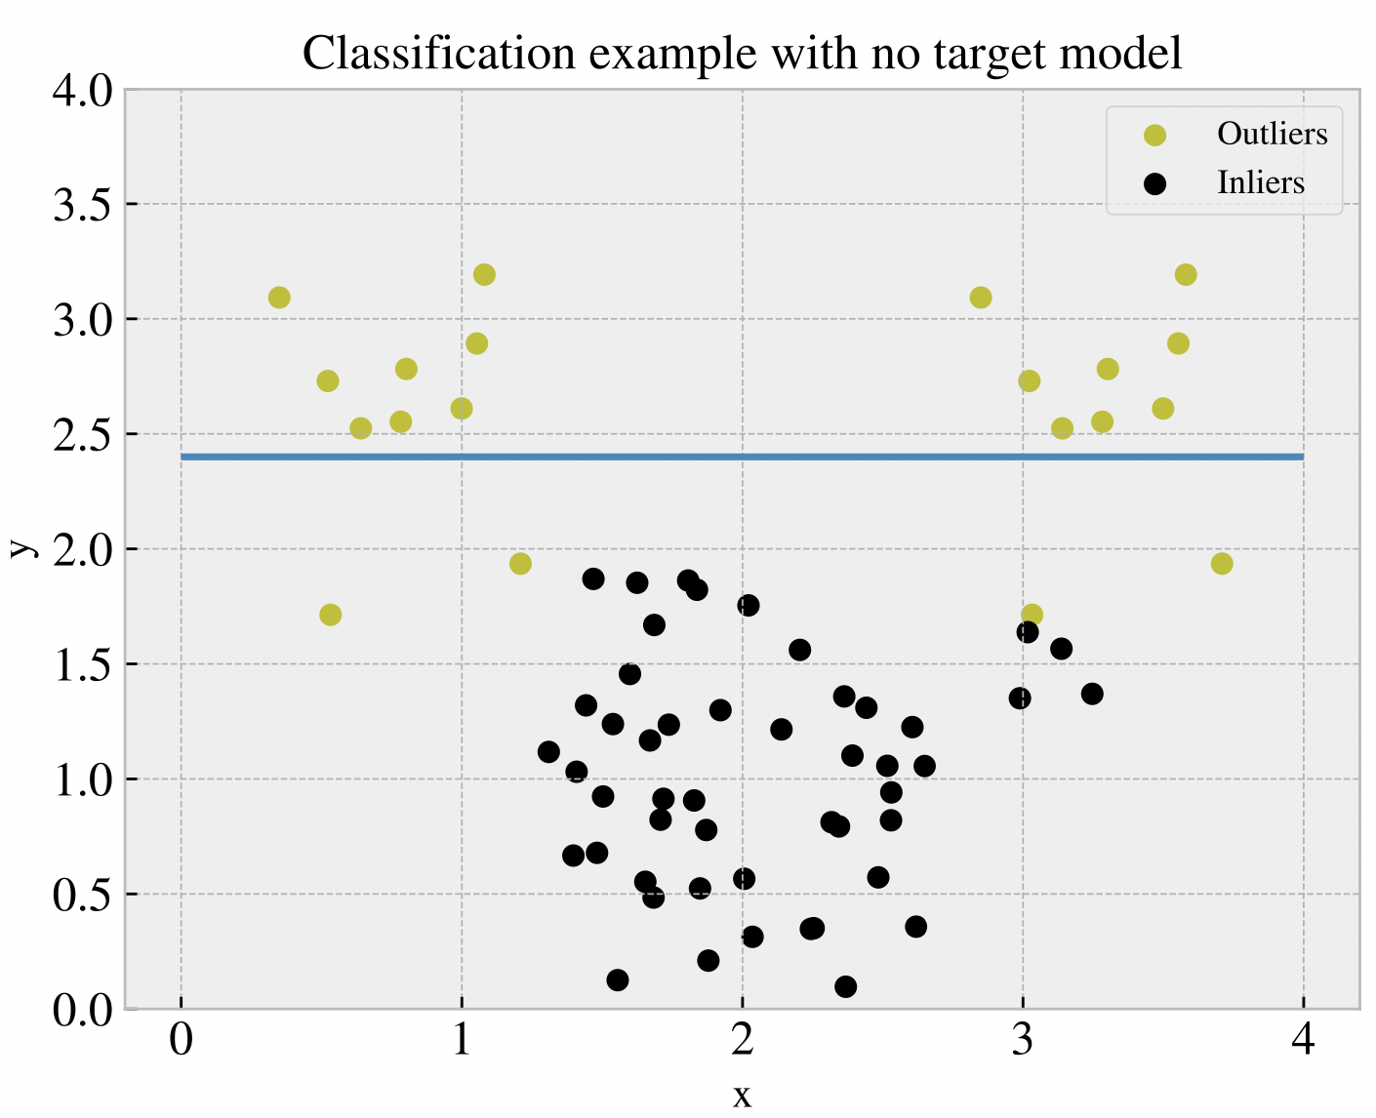
Anomaly detection
Point anomalies
Contextual anomalies
Collective anomalies

Slide 7
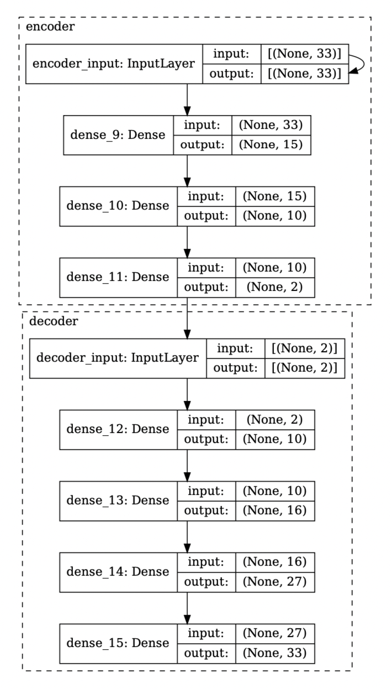
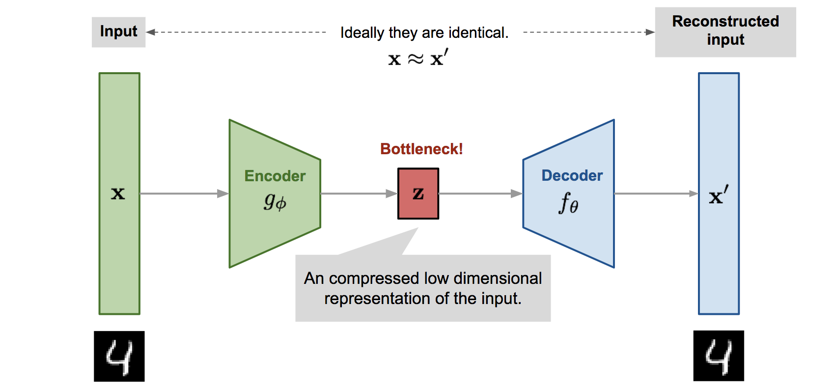
Auto Encoders
Reconstruction, not copying
Hyper parameters
Source: https://lilianweng.github.io/posts/2018-08-12-vae/

Slide 8
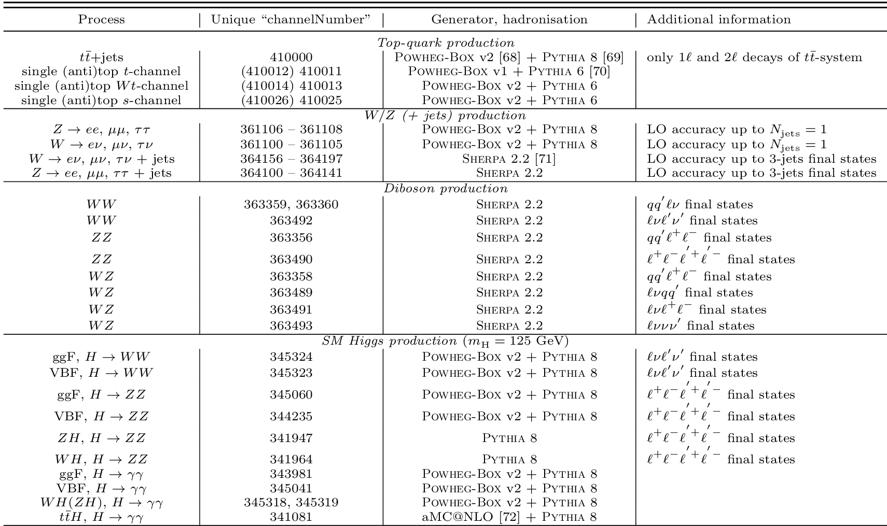
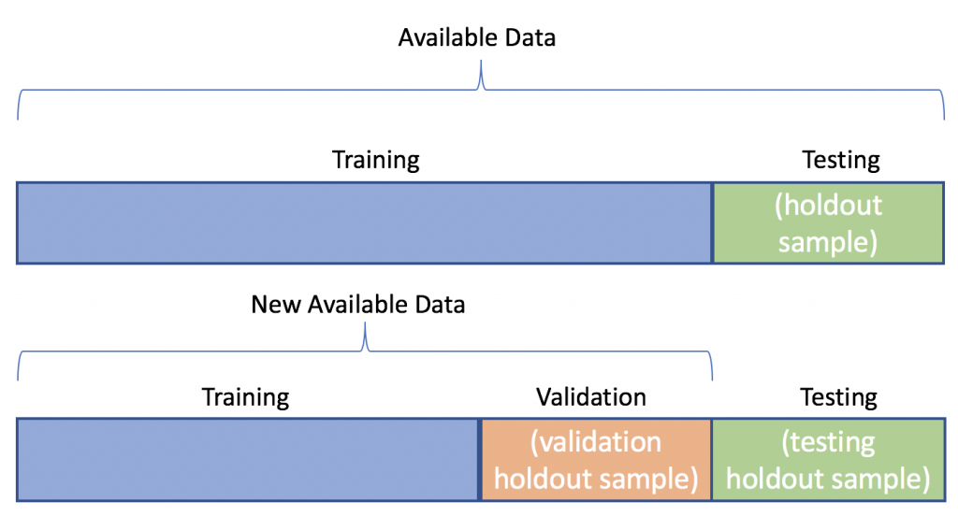
The data sets
Background samples
Signals
Supersymmetric models
Vector boson candidate
Randall-Sundrum Graviton
Dark matter candidate
Training, validation and test data sets
source: http://opendata.atlas.cern/release/2020/documentation/datasets/mc.html
source: https://algotrading101.com/learn/train-test-split/

Slide 9

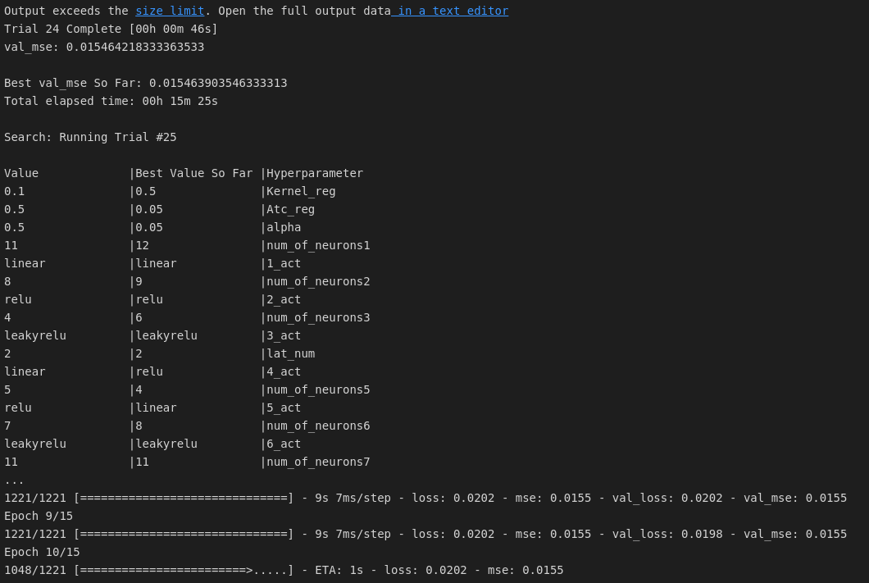
Training of the model
Scaling
Padding of features
Tuning and training (Keras-Tuner, hyperband)

Slide 10
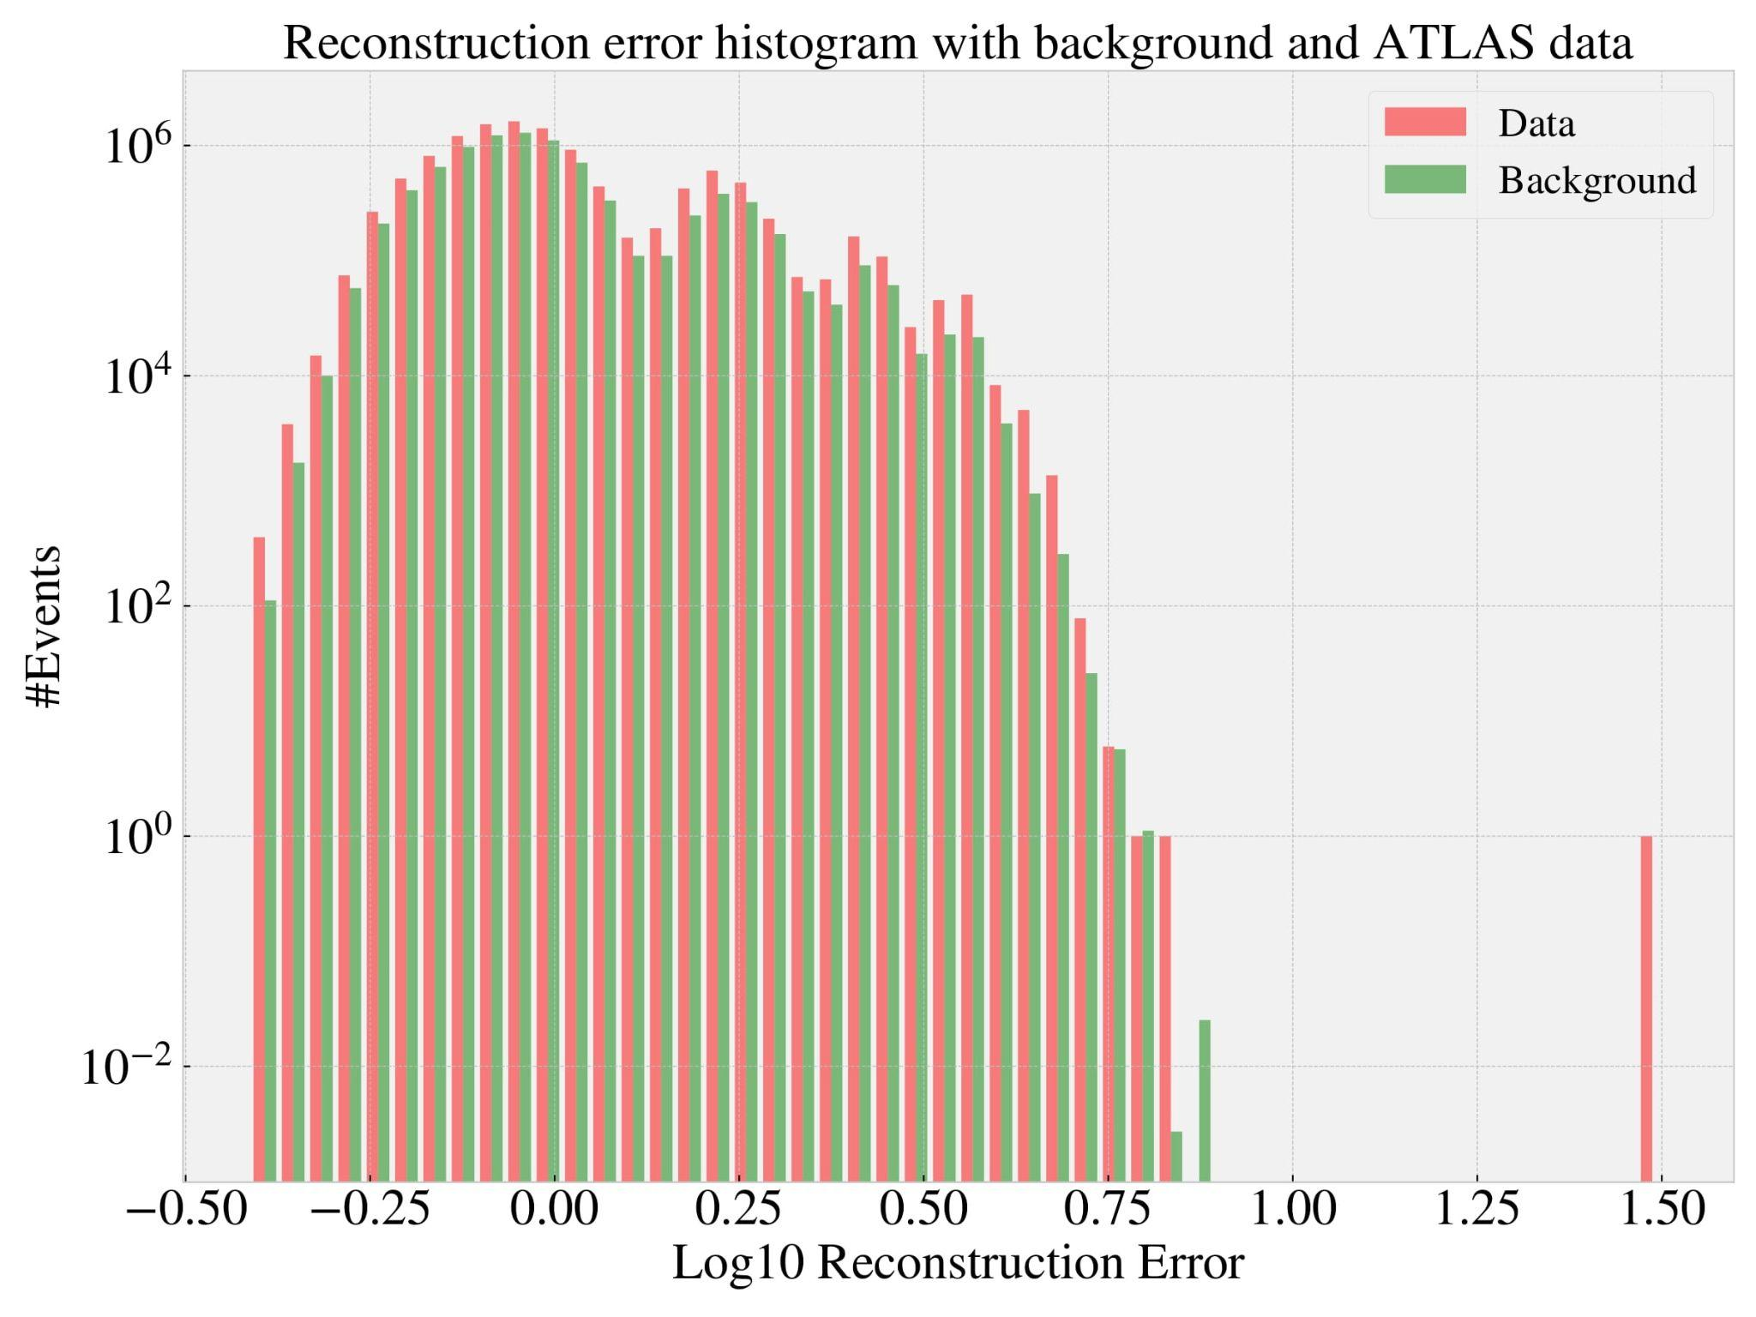
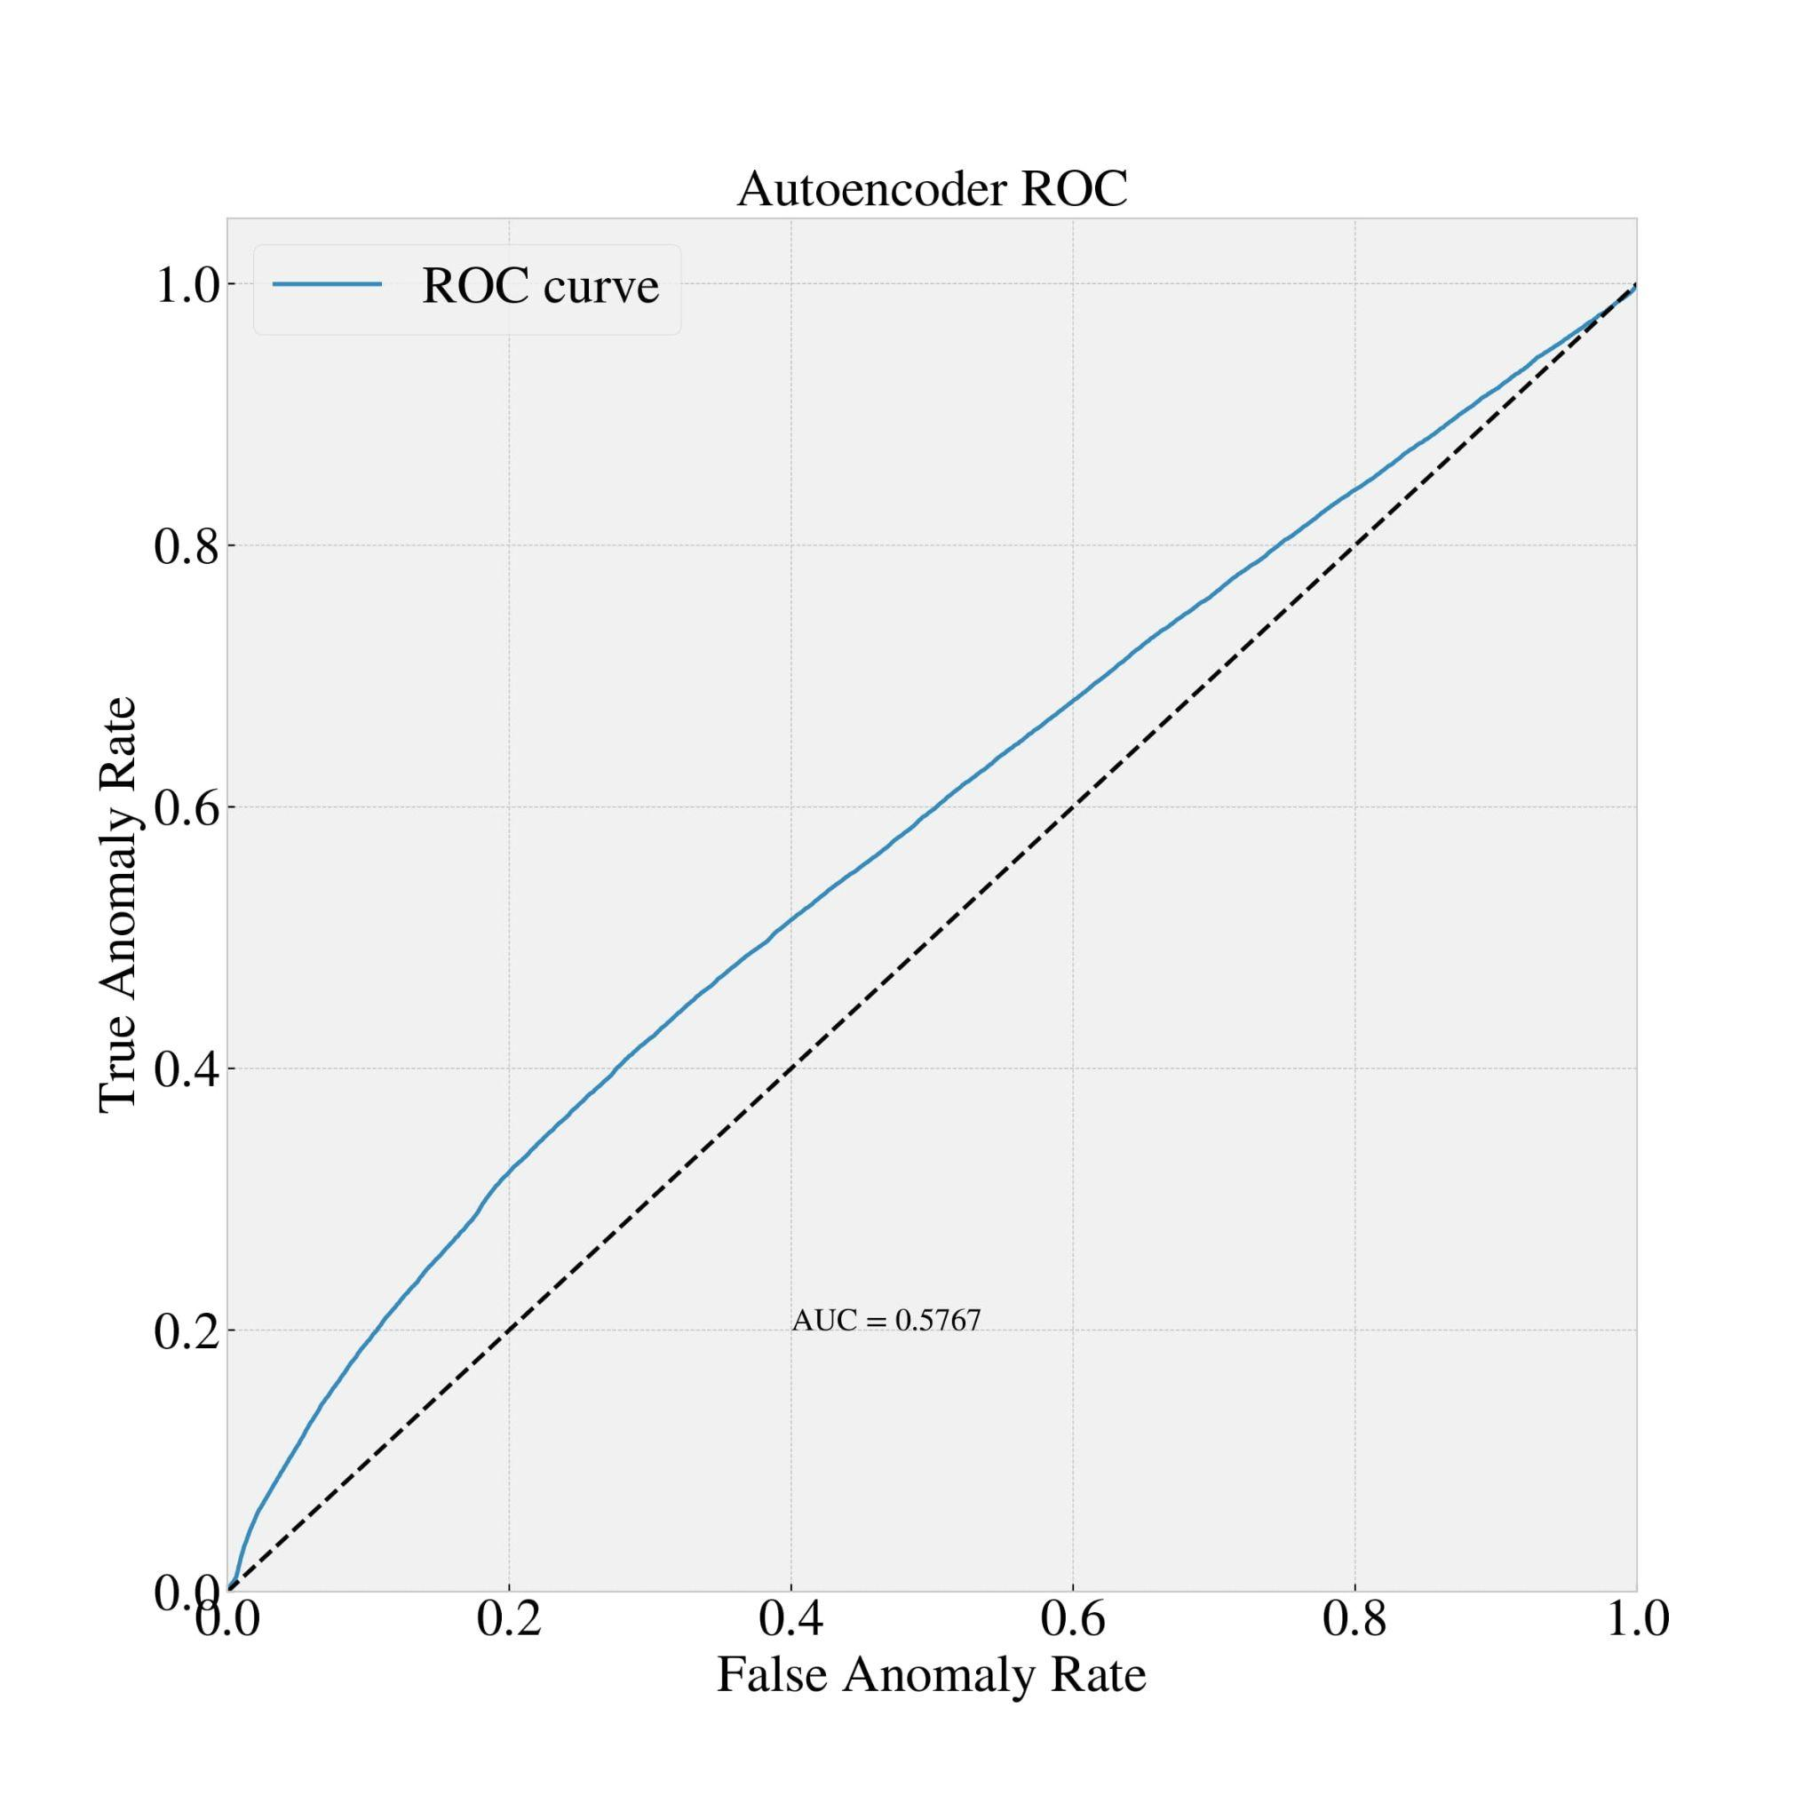
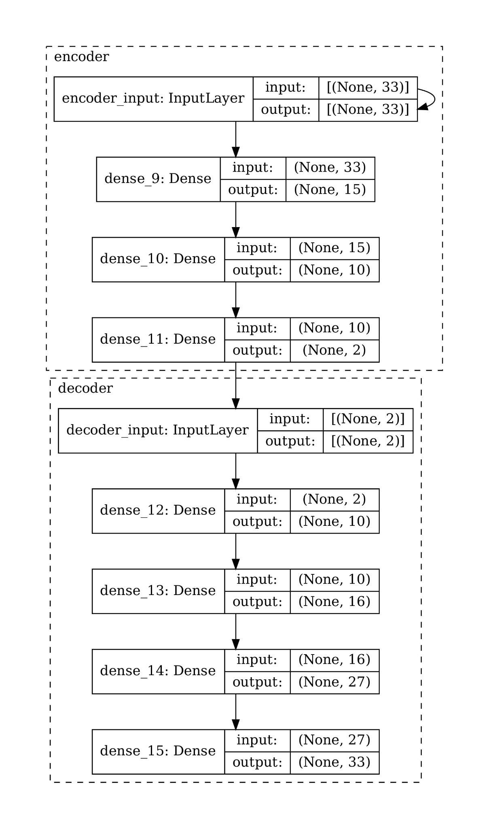
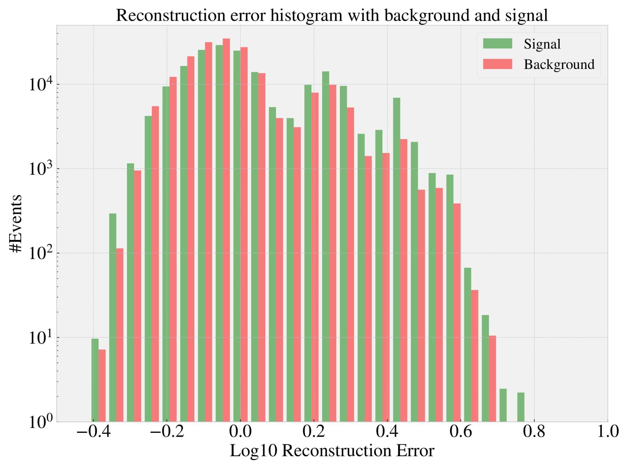
Results

Slide 11
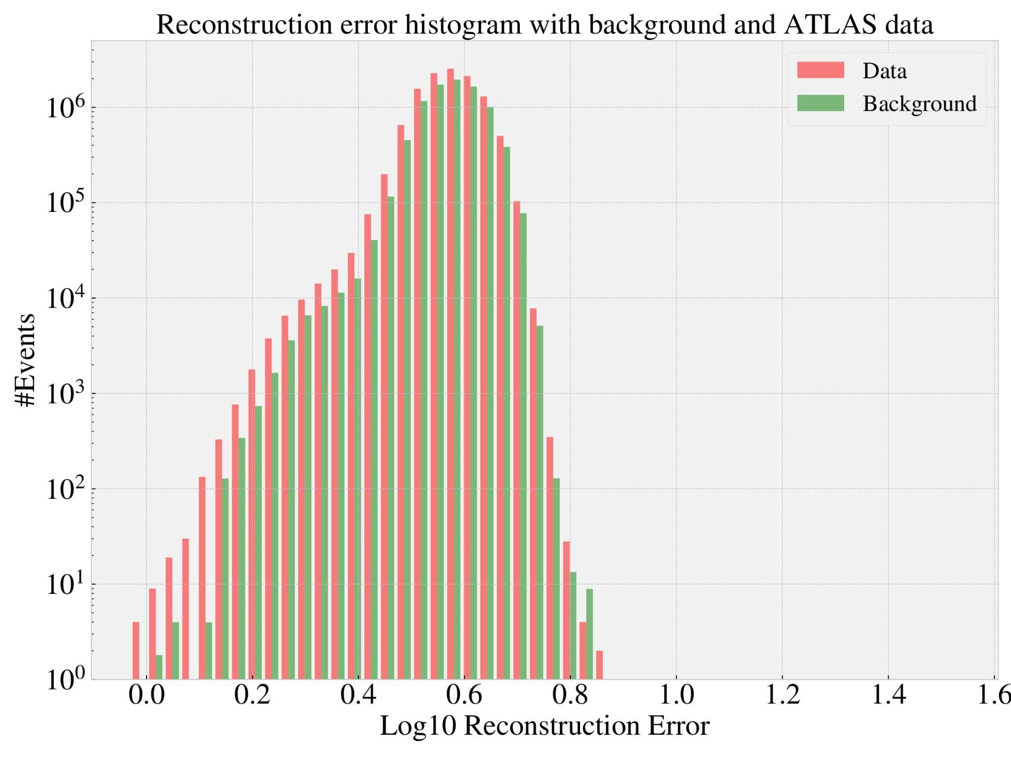
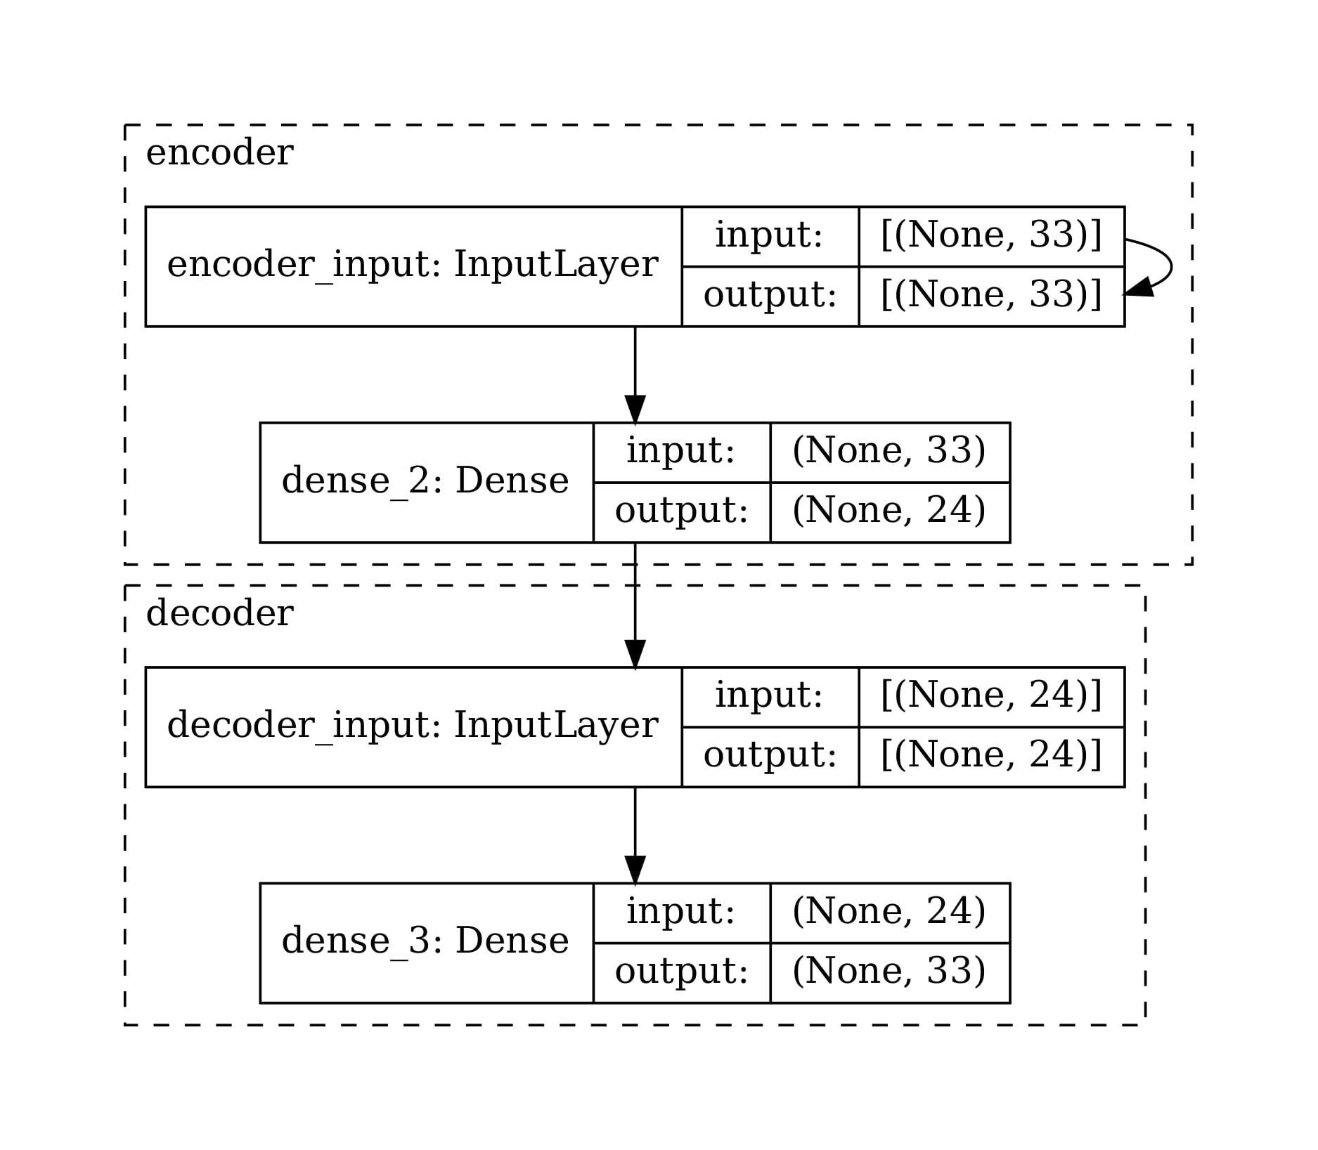
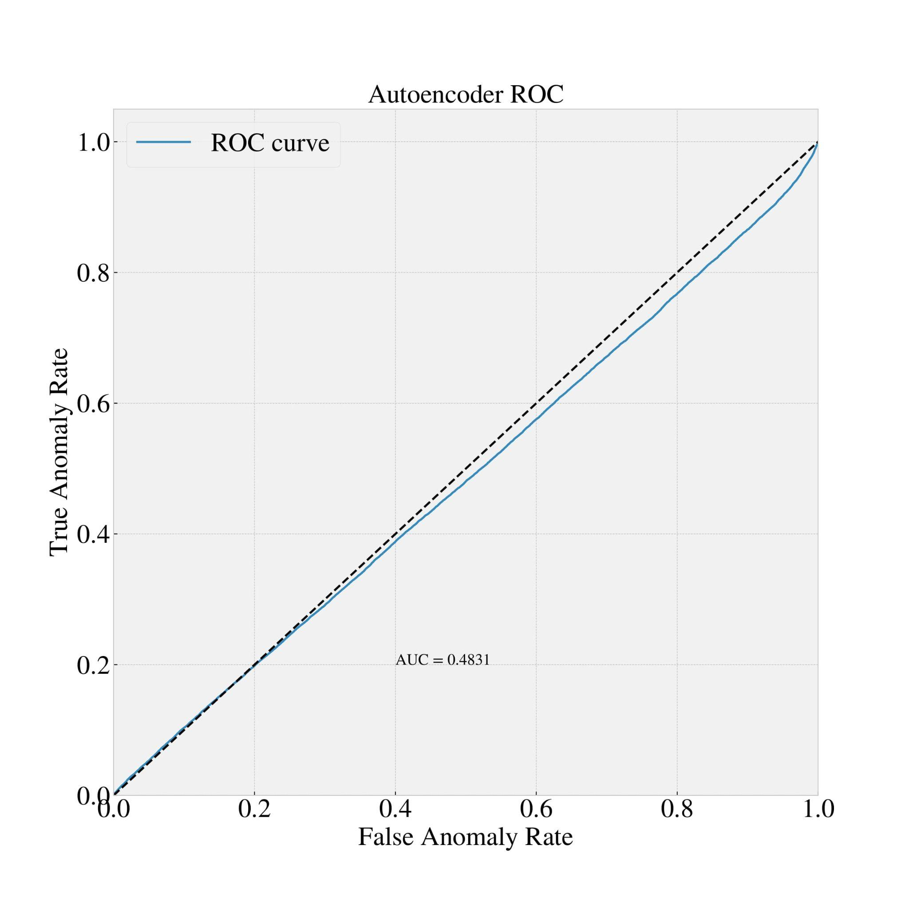
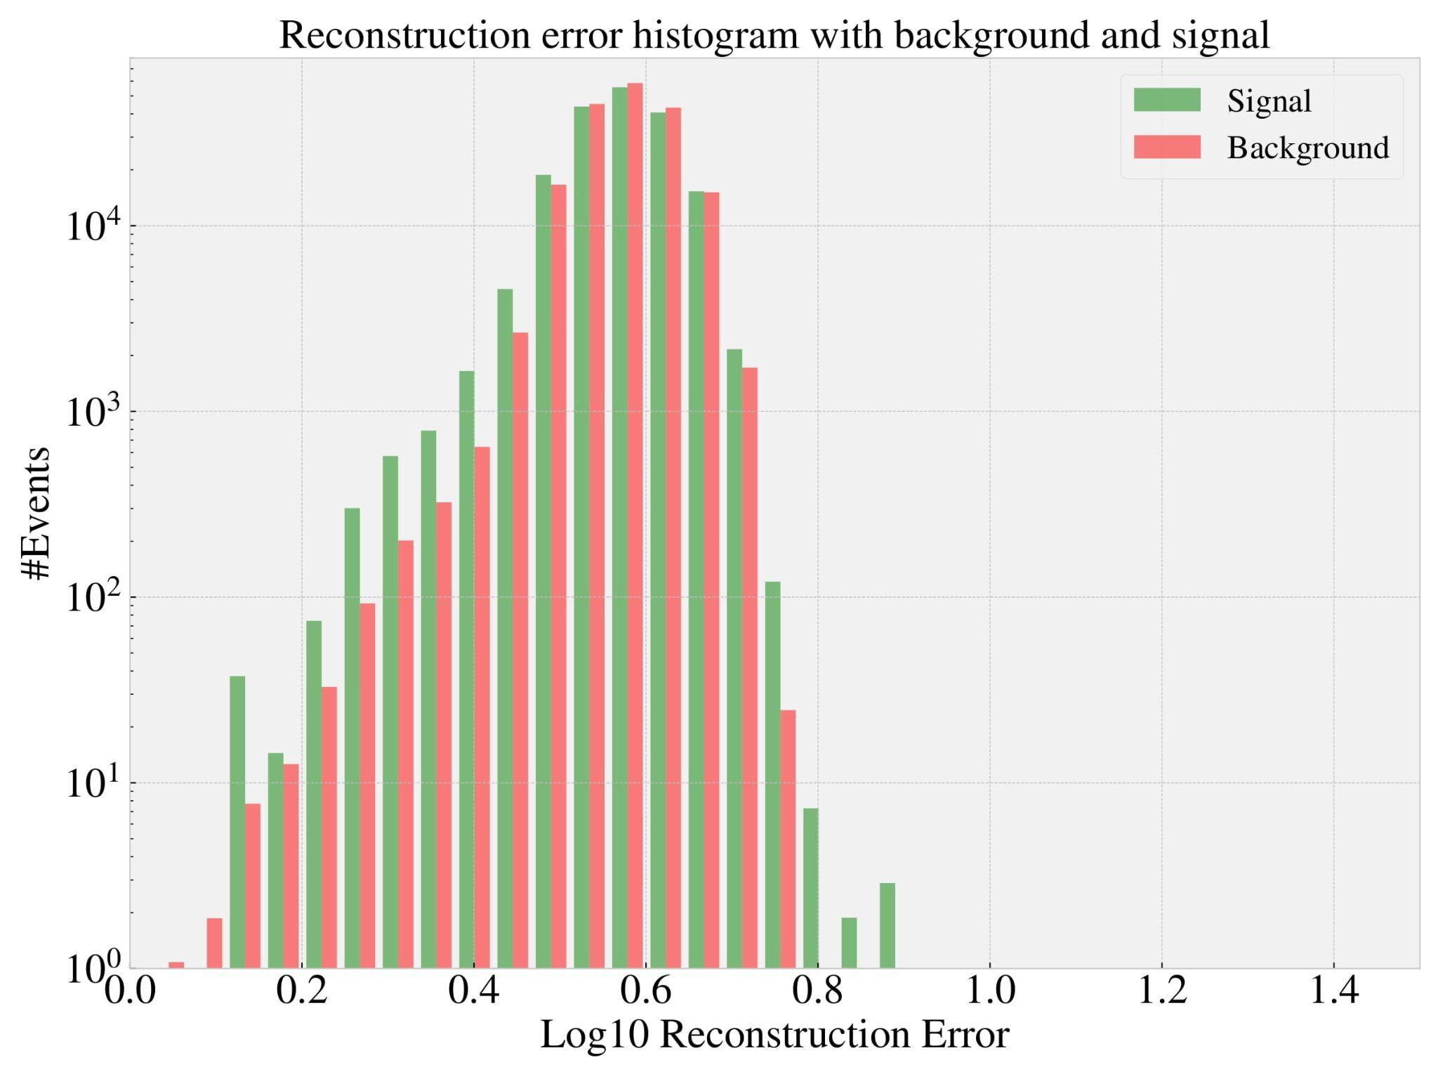
Small autoencoder

Slide 12
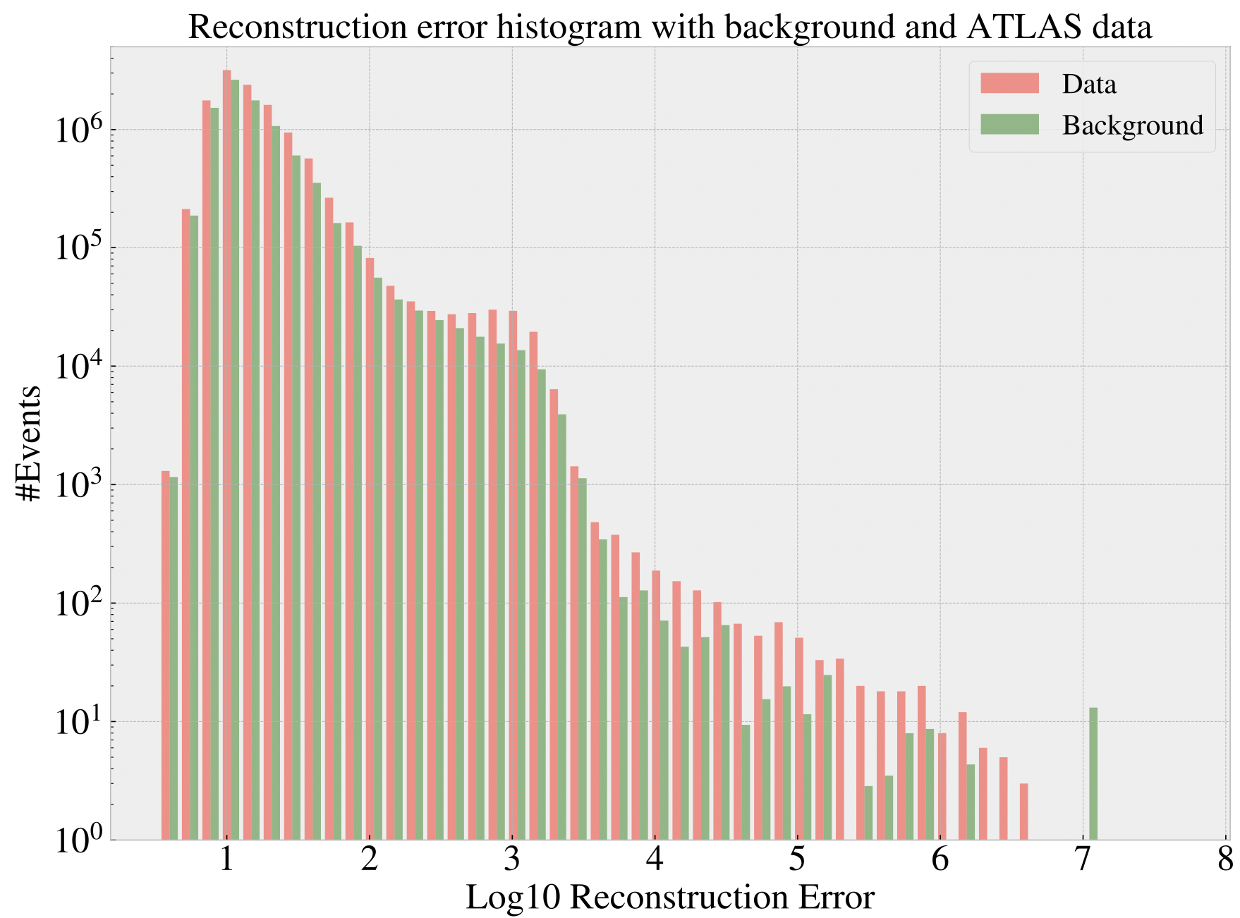

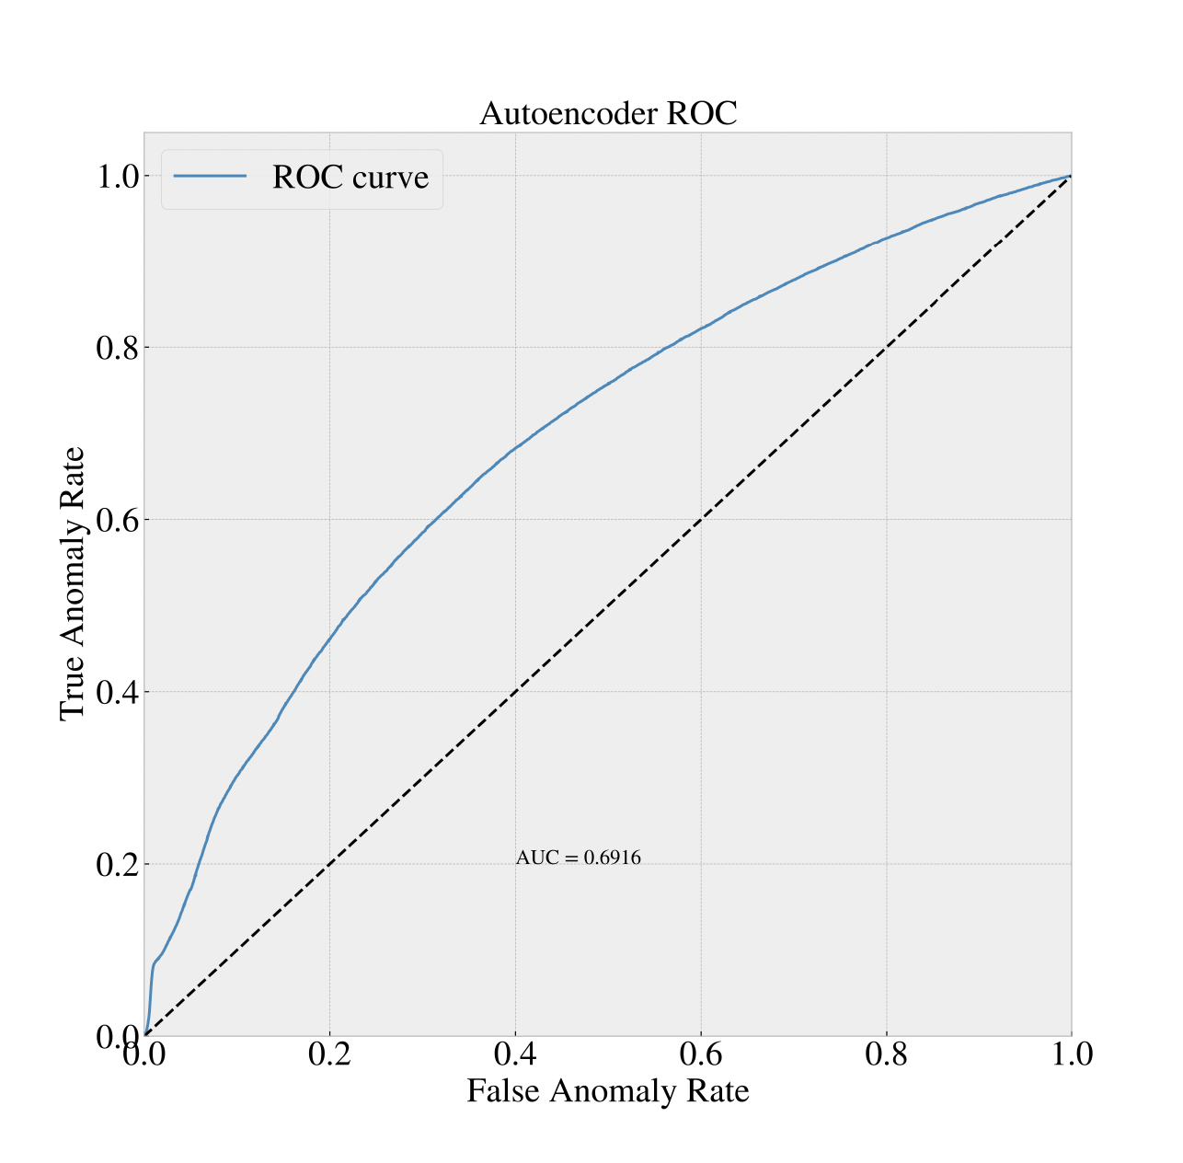
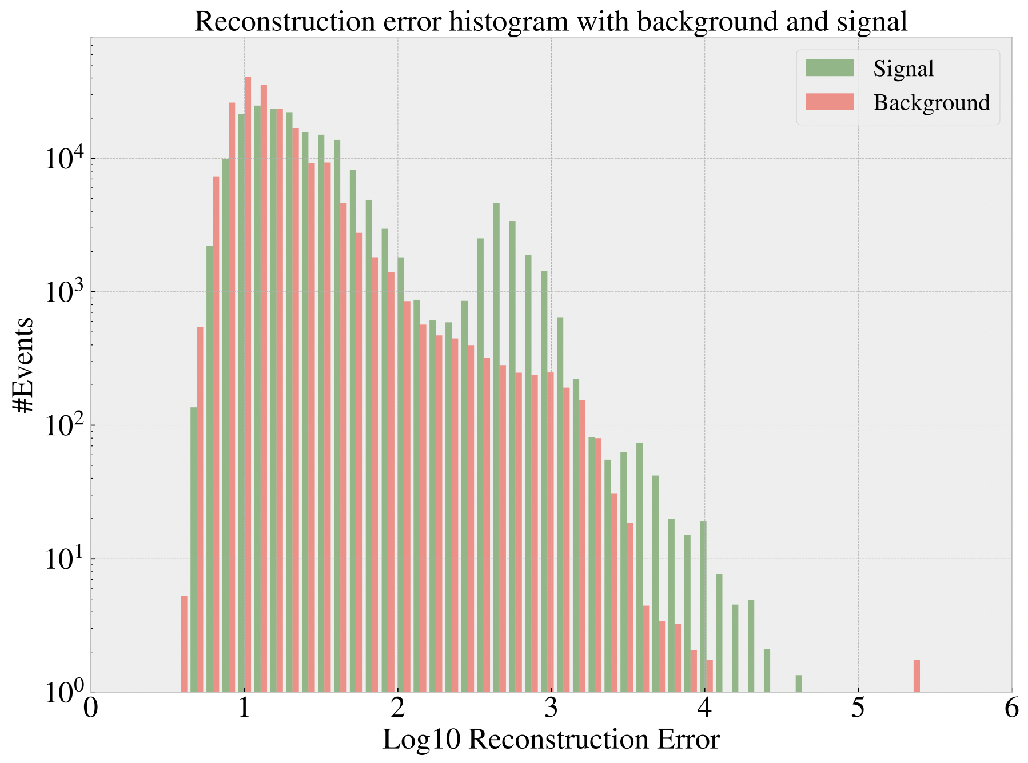
Standard scaling

Slide 13
Topics for discussion
Extended gridsearch
More hyper parameters
More computation time required
Better sampling for more accurate representation of sm processes
Reevaluating the metric for learning (weighted reconstruction error per feature)
Rethinking construction of higher level features

Slide 14
Conclusion

